Slide 1
ISG-5312-Genomic Data Analysis in Practice II-SEC001-1253
Teckla Akinyi

Slide 2
Reference paper
Structural variant calling based on :
Genome Sequencing of SARS-CoV-2 Allows Monitoring of Variants of Concern through Wastewater
The authors:
identify specific signature mutations from individual SARS-CoV-2 lineages in wastewater samples to estimate lineages circulating in Luxembourg.
compare circulating lineages and mutations to those detected in clinical samples amongst infected individuals.
We show that especially for dominant lineages, the allele frequencies of signature mutations from wastewater samples correspond to the occurrence of particular lineages in the population. In addition, we provide evidence that regional clusters can also be discerned.
results highlight the potential of genomic surveillance in wastewater samples based on amplicon short-read data.
Ref: Herold, M., d'Hérouël, A. F., May, P., Delogu, F., Wienecke-Baldacchino, A., Tapp, J., Walczak, C., Wilmes, P., Cauchie, H.-M., Fournier, G., & Ogorzaly, L. (2021). Genome Sequencing of SARS-CoV-2 Allows Monitoring of Variants of Concern through Wastewater. Water, 13(21), 3018. https://doi.org/10.3390/w13213018

Slide 3
Data availability
Waste water raw reads: SRA reads NCBI Accession: PRJNA765031
SARS-CoV2 reference genome: fasta file NCBI RefSeq: NC_045512.2
SARS-CoV2 annotation: annotated genome index
Human reference genome: ftp download NCBI Project number PRJNA31257

Slide 4
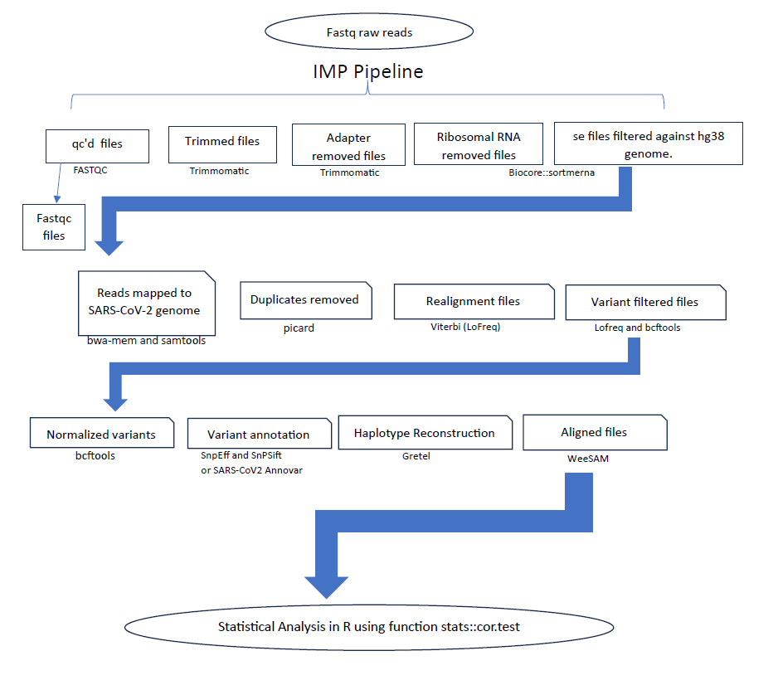
Workflow from ref paper

Slide 5
Deviations from workflow
Final project follows the paper’s workflow except for the steps highlighted in orange arrows:
1. Ribosomal RNA were not filtered out. This may account for why the data show polya adapter content remaining post trimming.
2. Instead of filtering using biocore, the data were filtered against human genome by concatenating the viral and human genome so that the reads that are human would map to human and viral to viral.
3. Variant annotation using snpEff was attempted however, software issues and limited time, resulted in the data not being annotated. A challenge here was also the genome was downloaded from ENA not NCBI – thus different sequence names.
1
2
3

Slide 6
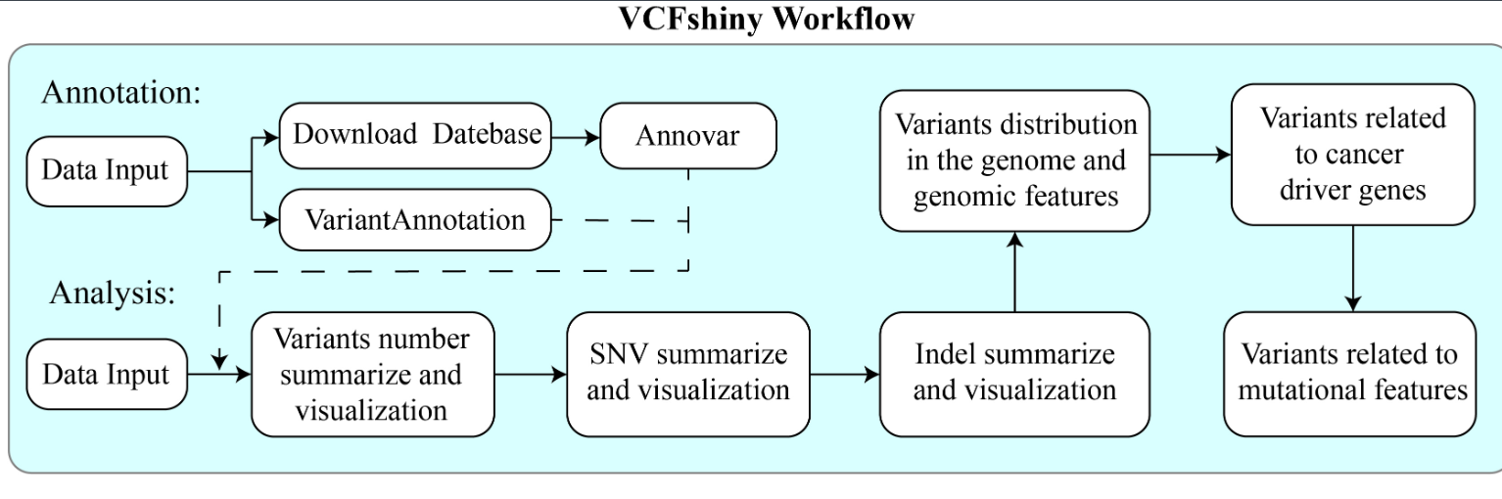
Statistical Analysis in R
Using R 4.2.2 the combined vcf file for all samples was uploaded and analysis attempted.
{VCFshiny} is a bioinformatic tool that allows annotation and analysis of variant calling files using a GUI according to the workflow below:
Installation and running:
install.package("shiny")
## install.packages("devtools") ## you may need install devtools first
devtools::install_github("123xiaochen/VCFshiny")
## Loading and run the package.
library(VCFshiny)
VCFshiny::startVCFshiny()

Slide 7
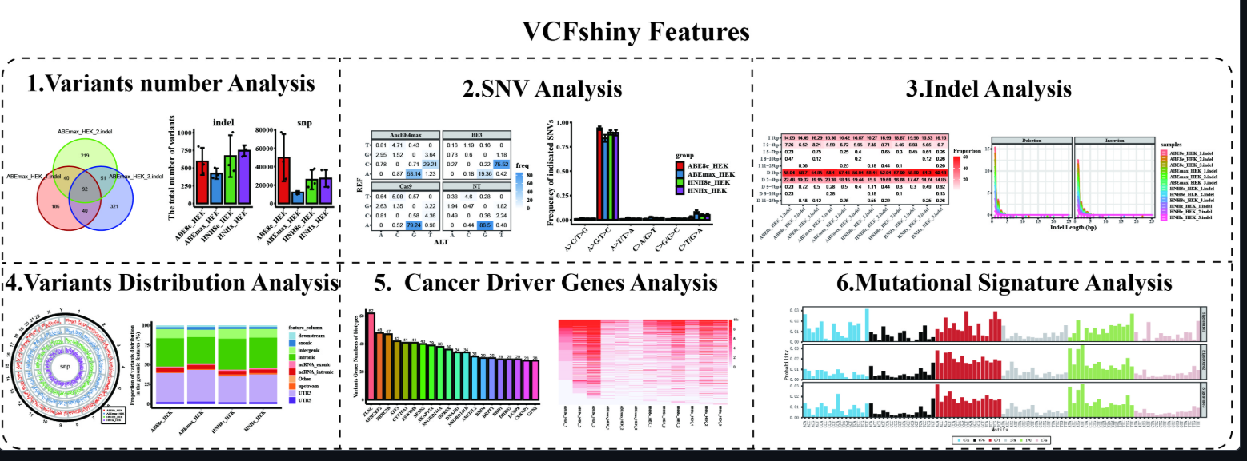
Statistical Analysis in R
{VCFshiny} offers the following analysis tools that can be used to annotate, summarize and visualize SNV data.

Slide 8
Statistical Analysis in R
{VCFshiny} offers an option to annotate using Annovar and VariantAnnotation.
This is a viable option for this project as the authors of the reference paper offer either snpeff or annovar for annotation.
“Variant annotation was performed with SnpEff v5.0 [40] and SnpSift v4.3 [41] or the SARS-CoV2 28 April 2020 version of Annovar”
VCFshiny is designed for cancer genetics but the steps of annotation can be used, following SNV and indel analysis to pull the most recurring annotations – reported as 231 and classify them through heatmap analysis.
Further characterization could includes the Number of nucleotide mutations per gene to extract information on the genes that are most impactful in SARS-CoV2.
After successful installation of VCFshiny v.0.1.0 in the R environment, allowed successful uploading of data but software crashes based on uninstalled dependencies limited downstream analysis.
Downloading dependencies continued to take a long time, with the extra challenge of no comprehensive list to reference for required dependencies.
Vcfshiny reference: Tao Chen, Chengcheng Tang, Wei Zheng, Yanan Qian, Min Chen, Qingjian Zou, Yinge Jin, Kepin Wang, Xiaoqing Zhou, Shixue Gou, Liangxue Lai, VCFshiny: an R/Shiny application for interactively analyzing and visualizing genetic variants, Bioinformatics Advances, Volume 3, Issue 1, 2023, vbad107, https://doi.org/10.1093/bioadv/vbad107

